Slide 1
The Language of Bits
Computer Organisation and Architecture
The Language of Bits
&
Number System
PROPRIETARY MATERIAL. © 2014 The McGraw-Hill Companies, Inc. All rights reserved. No part of this PowerPoint slide may be displayed, reproduced or distributed in any form or by any means, without the prior written permission of the publisher, or used beyond the limited distribution to teachers and educators permitted by McGraw-Hill for their individual course preparation. PowerPoint Slides are being provided only to authorized professors and instructors for use in preparing for classes using the affiliated textbook. No other use or distribution of this PowerPoint slide is permitted. The PowerPoint slide may not be sold and may not be distributed or be used by any student or any other third party. No part of the slide may be reproduced, displayed or distributed in any form or by any means, electronic or otherwise, without the prior written permission of McGraw Hill Education (India) Private Limited.
1

Slide 2

Outline
Boolean Algebra
Positive Integers
Negative Integers
Floating-Point Numbers
Strings
2

Slide 3
What does a Computer Understand ?
Computers do not understand natural human languages, nor programming languages
They only understand the language of bits
Bit
Bit
0 or 1
0 or 1
0 or 1
0 or 1
0 or 1
0 or 1
0 or 1
Byte
8 bits
0 or 1
0 or 1
0 or 1
Word
4 bytes
1024 bytes
0 or 1
0 or 1
kiloByte
0 or 1
0 or 1
10⁶ bytes
megaByte
0 or 1
3

Slide 4
Review of Logical Operations
A + B (A or B)
A.B ( A and B)
A | B | A + B
0 | 0 | 0
1 | 0 | 1
0 | 1 | 1
1 | 1 | 1
A | B | A.B
0 | 0 | 0
1 | 0 | 0
0 | 1 | 0
1 | 1 | 1
4

Slide 5
Review of Logical Operations - II
A | B | A NAND B
0 | 0 | 1
1 | 0 | 1
0 | 1 | 1
1 | 1 | 0
A | B | A NOR B
0 | 0 | 1
1 | 0 | 0
0 | 1 | 0
1 | 1 | 0
NAND and NOR operations
These are universal operations. They can be used to implement any Boolean function.
5

Slide 6
Review of Logical Operations
XOR Operation : (A B)
A | B | A XOR B
0 | 0 | 0
1 | 0 | 1
0 | 1 | 1
1 | 1 | 0
6

Slide 7
Review of Logical Operations
NOT operator
Definition: 0 = 1, and 1 = 0
Double negation: A = A, NOT of (NOT of A) is equal to A itself
OR and AND operators
Identity: A + 0 = A, and A.1 = A
Annulment: A + 1 = 1, A.0 = 0
7

Slide 8
Idempotence: A + A = A, A.A = A, The result of computing the OR and AND of A with itself is A.
Complementarity: A + A = 1, A.A = 0
Commutativity: A + B = B + A, A.B = B.A, the order of Boolean variables does not matter
Associativity: A+(B+C) = (A+B)+C, A.(B.C) = (A.B).C, similar to addition and multiplication.
Distributivity: A.(B + C) = A.B + A.C, A+ (B.C) = (A+B). (A+C) → Use this law to open up parantheses and simplify expressions

Slide 9
De Morgan's Laws
Two very useful rules
A + B = A.B
A.B = A + B
9

Slide 10

Consensus Theorem
Prove :
X.Y + X.Z + Y.Z = X.Y + X.Z
10

Slide 11
K-Map (Karnaugh Map)
Pictorial method that is utilised to minimise various Boolean expressions without using the Boolean algebra theorems along with the equation manipulations.
The K-map can easily take two forms, namely, Sum of Product or SOP and Product of Sum or POS

Slide 12
Steps to Solve K-Map
1. Select a K-map according to the total number of variables.
2. Identify maxterms or minterms as given in the problem.
3. For SOP, put the 1’s in the blocks of the K-map with respect to the minterms (elsewhere 0’s).
4. For POS, putting 0’s in the blocks of the K-map with respect to the maxterms (elsewhere 1’s).
5. Making rectangular groups that contain the total terms in the power of two, such as 2,4,8 ..(except 1) and trying to cover as many numbers of elements as we can in a single group.
6. From the groups that have been created in step 5, find the product terms and then sum them up for the SOP form.
SOP FORM
1. 3 variables K-map:
Z = ∑P, Q, R (1, 3, 6, 7)

Slide 13
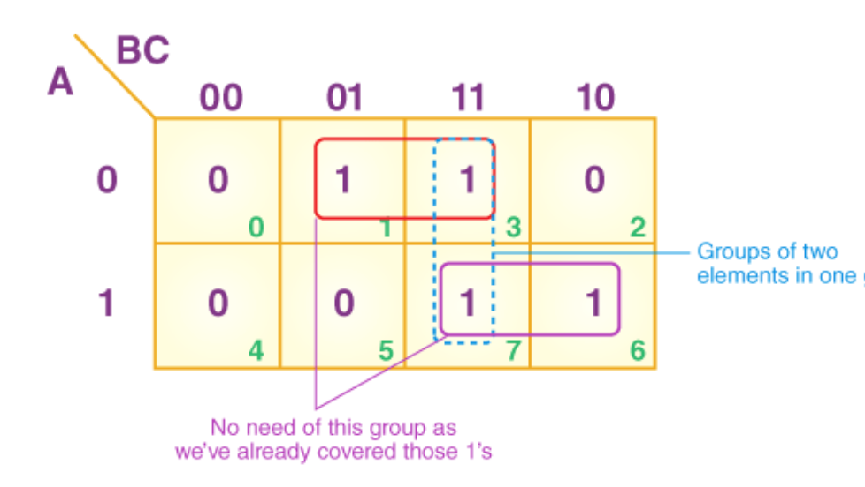
From the red group, the product term would be —
A’C
From the green group, the product term would be —
AB
If we sum these product terms, then we will get this final expression (A’C + AB)

Slide 14
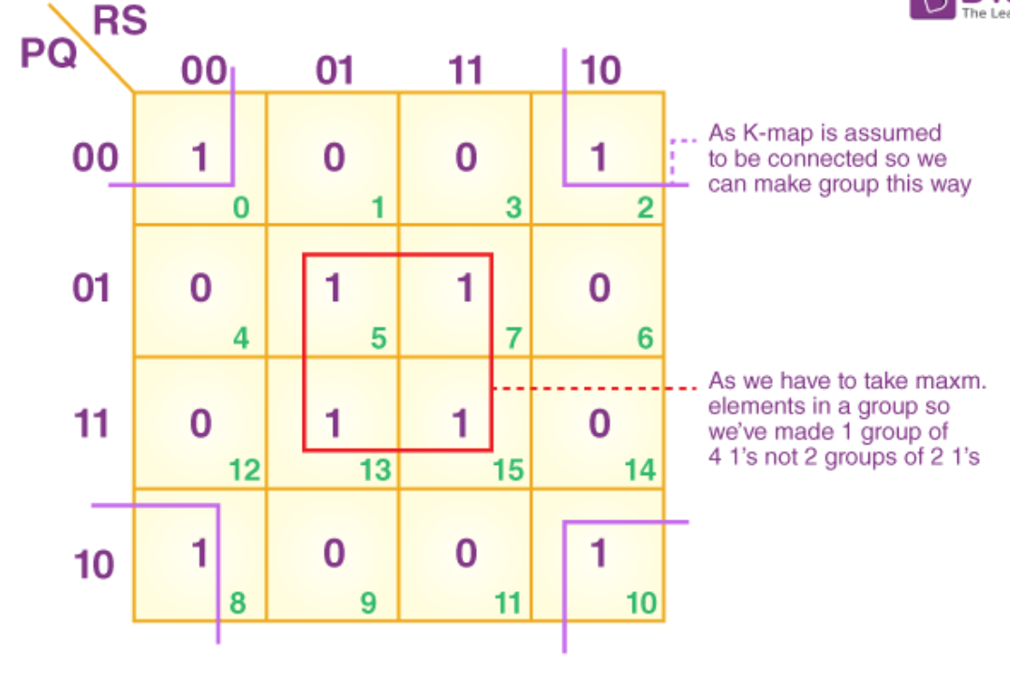
4 variables K-map:
F (A, B, C, D) = ∑(0, 2, 5, 7, 8, 10, 13, 15)
CD
AB
From the red group, the product term would be —
BD
From the lilac group, the product term would be —
B’D’
If we sum these product terms, then we will get this final expression (BD + B’D’)

Slide 15
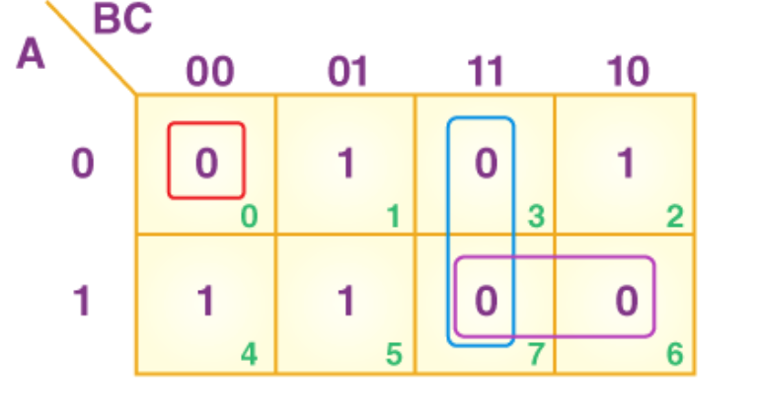
POS FORM: 3 variables K-map
F (P, Q, R) = π(0,3,6,7)

Slide 16
POS FORM: 3 variables K-map
F (P, Q, R) = π(0,3,6,7)
QR
P
final expression –
(P’ + Q’) (P’ + R’) (P + Q + R)

Slide 17
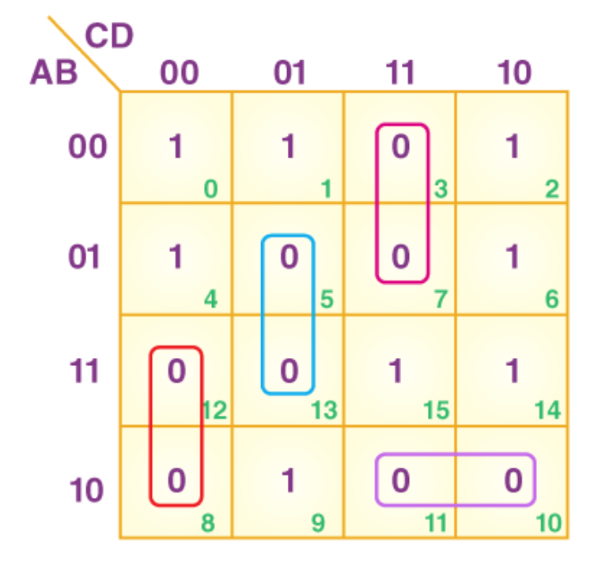
4 variables K-map
F (P, Q, R, S) = π (3, 5, 7, 8, 10, 11, 12, 13)

Slide 18
4 variables K-map
F (P, Q, R, S) = π (3, 5, 7, 8, 10, 11, 12, 13)
Finally, we will express these in the form of the product –
(R + S’+ Q’).(R’ + S’+A).(P’+ R + S).(P’+ Q + R’)
Notes:
Pitfall – Always remember that POS ≠ (SOP)’
*Here, the correct form would be (POS of F) = (SOP of F’)’
https://byjus.com/gate/introduction-of-k-map-karnaugh-map-notes/

Slide 19
Outline
Boolean Algebra
Positive Integers
Negative Integers
Floating Point Numbers
Strings
19

Slide 20
Representing Positive Integers
Ancient Roman System
Issues :
There was no notion of 0
Very difficult to represent large numbers
Addition, and subtraction (very difficult)
Symbol | I | V | X | L | C | D | M
Value | 1 | 5 | 10 | 50 | 100 | 500 | 1000
20

Slide 21
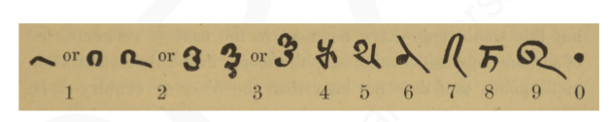
Indian System
Bakshali numerals, 7th century AD
Uses the place value system
5301 = 5 * 10³ + 3 * 10² + 0 * 10¹ + 1*10⁰
Example in base 10
21

Slide 22
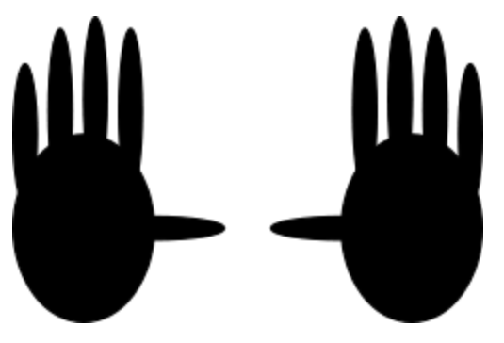
Number Systems in Other Bases
Why do we use base 10 ?
because ...
22

Slide 23

What if we had a world in which ...
People had only two fingers.
23

Slide 24
Binary Number System
They would use a number system with base 2.
Number in decimal
Number in binary
5
101
100
1100100
500
111110100
1024
10000000000
24

Slide 25
MSB and LSB
MSB (Most Significant Bit) → The leftmost bit of a binary number. E.g., MSB of 1110 is 1
LSB (Least Significant Bit) → The rightmost bit of a binary number. E.g., LSB of 1110 is 0
25

Slide 26
Hexadecimal and Octal Numbers
Hexadecimal numbers
Base 16 numbers – 0,1,2,3,4,5,6,7,8,9,A,B,C,D,E,F
Start with 0x
Octal Numbers
Base 8 numbers – 0,1,2,3,4,5,6,7
Start with 0
26

Slide 27
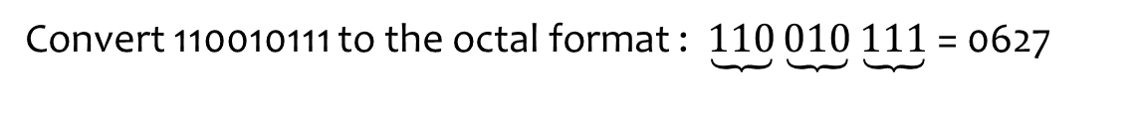
Examples
Convert 110010111 to the octal format : $\underbrace{110}\underbrace{010}\underbrace{111}$ = 0627
Convert 111000101111 to the hex format : $\underbrace{1110}\underbrace{0010}\underbrace{1111}$ = 0xE2F

Slide 28
Outline
Boolean Algebra
Positive Integers
Negative Integers
Floating Point Numbers
Strings
28

Slide 29
Representing Negative Integers
Problem
Assign a binary representation to a negative integer
Consider a negative integer, S
Let its binary representation be : x_{n}x_{n-1….}x₂x₁ (x_{i}=0/1)
We can also expand it to represent an unsigned, +ve, number, N
If we interpret the binary sequence as :
An unsigned number, we get N
A signed number, we get S
29

Slide 30
We need a mapping :
F : S → N (mapping function)
S → set of numbers (both positive and negative – signed)
N → set of positive numbers (unsigned)
Set of
+ve and -ve
numbers
mapping
Set of +ve
numbers
30

Slide 31
Properties of the Mapping Function
Preferably, needs to be a one to one mapping
All the entries in the set, S, need to be mapped
It should be easy to perform addition and subtraction operations on the representation of signed numbers
Assume an n bit number system
SgnBit(u) = 1 , u < 0
0 , u >= 0
31

Slide 32
Sign-Magnitude Base Representation
sign bit
|u|
Examples :
-5 in a 4 bit number system : 1101
5 in a 4 bit number system : 0101
-3 in a 4 bit number system : 1011
32

Slide 33

Problems
There are two representations for 0
000000
100000
Addition and subtraction are difficult
The most important takeaway point :
Notion of the sign bit
33

Slide 34

1's Complement Representation
Examples in a 4 bit number system
3 → 0011
-3 → 1100
5 → 0101
-5 → 1010
34

Slide 35
Problems
Two representations for 0
0000000
1111111
Easy to add +ve numbers
Hard to add -ve numbers
Point to note :
The idea of a complement
35

Slide 36
Bias Based Approach
Consider a 4 bit number system with bias equal to 7
-3 → 0100
3 → 1010
F(u+v) = F(u) + F(v) – bias
Multiplication is difficult
36

Slide 37
The Number Circle
0000 (0)
1111 (15)
0001 (1)
1110 (14)
0010 (2)
1101 (13)
0011 (3)
Increment
1100 (12)
0100 (4)
1011 (11)
0101 (5)
1010 (10)
0110 (6)
0111 (7)
1001 (9)
1000 (8)
Clockwise: increment
Anti-clockwise: decrement
37

Slide 38
Number Circle with Negative Numbers
0000 (0)
1111 (-1)
0001 (1)
1110 (-2)
0010 (2)
1101 (-3)
0011 (3)
Increment
1100 (-4)
0100 (4)
1011 (-5)
0101 (5)
0110 (6)
1010 (-6)
0111 (7)
1001 (-7)
1000 (-8)
break point
38

Slide 39
Using the Number Circle
To add M to a number, N
locate N on the number circle
If M is +ve
Move M steps clockwise
If M is -ve
Move M steps anti-clockwise, or 2^{n} – M steps clockwise
If we cross the break-point
We have an overflow
The number is too large/ too small to be represented
39

Slide 40
2's Complement Notation
F(u) is the index of a point on the number circle. It varies from 0 to 2^{n} - 1
Examples
4 → 0100
-4 → 1100
5 → 0101
-3 → 1101
40

Slide 41
Properties of the 2's Complement Notation
Range of the number system :
-2^{(n-1)} to 2^{n-1} – 1
There is a unique representation for 0 → 000000
msb of F(u) is equal to SgnBit(u)
Refer to the number circle
For a +ve number, F(u) < 2^{(n-1)}. MSB = 0
For a -ve number, F(u) >= 2^{(n-1)}. MSB = 1
41

Slide 42
Properties - II
Every number in the range [-2^{(n-1)},2^{(n-1)} – 1]
Has a unique mapping
Unique point in the number circle
a ≡ b → (a = b mod 2^{n})
≡ means same point on the number circle
F(-u) ≡2^{n} – F(u)
Moving F(u) steps counter clock wise is the same as moving 2^{n} – F(u) steps clockwise from 0
42

Slide 43
Prove : F(u+v) ≡ F(u) + F(v)
Start at point u
Its index is F(u)
If v is +ve,
move v points clockwise. We arrive at F(u+v).
Its index is equal to (F(u) + v) mod 2^{n}.
Since v = F(v), we have F(u+v) = ( F(u) + F(v) ) mod 2^{n}
43

Slide 44
Prove : F(u+v) ≡ F(u) + F(v)
If v is -ve,
move |v| points anti-clockwise.
Same as moving 2^{n} – |v| points clockwise.
We arrive at F(u+v).
F(v) = 2^{n} -|v|
The index – F(u+v) – is equal to:
(F(u) + 2^{n} – |v|) mod 2^{n}= (F(u) + F(v)) mod 2^{n}
44

Slide 45
Subtraction
F(u-v) ≡ F(u) + F(-v)
≡ F(u) + 2^{n} - F(v)
Subtraction is the same as addition
Compute the 2's complement of F(v)
45

Slide 46
Prove that :
Prove that :
F(u*v) ≡ F(u) * F(v)
46

Slide 47
Computing the 2's Complement
2^{n} – u
= 2^{n} – 1 - u + 1
= ~u + 1
~u (1's complement)
1's complement of 0100 2's complement of 0100
1111
1011
0100
0001
1011
1100
47

Slide 48
Sign Extension
Convert a n bit number to a m bit 2's complement number (m > n)
+ve
Add (m-n) 0s in the msb positions
Example, convert 0100 to 8 bits → 0000 0100
-ve
F(u) = 2^{n} – |u| (n bit number) system
Need to calculate F'(u) = 2^{m} -|u|
48

Slide 49
Sign Extension - II
2^{m} – u – (2^{n} – u)
= 2^{m} – 2^{n}
= 2^{n} + 2^{(n+1)} + … + 2^{(m-1)}
= 11110000
m-n
n
F'(u) = F(u) + 2^{m} – 2^{n}
49

Slide 50
Sign Extension - III
To convert a negative number :
Add (m-n) 1s in the msb positions
In both cases, extend the sign bit by :
(m-n) positions
50

Slide 51
The Overflow Theorem
Add : u + v
If uv < 0, there will never be an overflow
Let us go back to the number circle
There is an overflow only when we cross the break-point
If uv = 0, one of the numbers is 0 (no overflow)
If uv > 0, an overflow is possible
51

Slide 52
Number Circle: uv < 0
0
-1
1
-2
2
-3
u=1
3
v=-4
-4
52

Slide 53
Number Circle: uv > 0
0
-1
1
-2
2
-3
u=1
3
v=3
-4
overflow
53

Slide 54
Conditions for an Overflow
uv <= 0
Never
uv > 0 ( u and v have the same sign)
The sign of the result is different from the sign of u
54

Slide 55
Outline
Boolean Algebra
Positive Integers
Negative Integers
Floating-Point Numbers
Strings
55

Slide 56
Floating-Point Numbers
What is a floating-point number ?
2.356
1.3e-10
-2.3e+5
What is a fixed-point number ?
Number of digits after the decimal point is fixed
3.29, -1.83
56

Slide 57
Generic Form for Positive Numbers
Generic form of a number in base 10
Example :
3.29 = 3 * 10⁰ + 2*10⁻¹ + 9*10⁻²
57

Slide 58
Generic Form in Base 2
Generic form of a number in base 2
Number
Expansion
0.375
2
–2
+2
–3
1
0
2
1.5
0
–1
2
+2
2.75
1
–1
–2
2
+2
+2
17.625
4
0
–1
–3
2
+2
+2
+2
58

Slide 59
Binary Representation
Take the base 2 representation of a floating-point (FP) number
Each coefficient is a binary digit
Number
Expansion
BinaryRepresentation
0.375
–2 –3
0.011
2 + 2
1
0
2
1.0
1.5
2⁰ + 2^{–1}
1.1
2.75
1 –1
-2
10.11
2 +2
+ 2
17.625
4 0
–1 -3
10001.101
2 +2
+ 2 +2
59

Slide 60
Normalized Form
Let us create a standard form of all floating point numbers
S → sign bit, P → significand
M → mantissa, X → exponent, Z → set of integers
60

Slide 61
Examples (in decimal)
1.3827 * 1e-23
Significand (P) = 1.3827
Mantissa (M) = 0.3827
Exponent (X) = -23
Sign (S) = 0
-1.2*1e+5
P = 1.2 , M = 0.2
S = 1, X = 5
61

Slide 62
IEEE 754 Format
General Principles
The significand is of the form : 1.xxxxx
No need to waste 1 bit representing (1.) in the significand
We can just save the mantissa bits
Need to also store the sign bit (S), exponent (X)
62

Slide 63
IEEE 754 Format - II
Sign(S)
Exponent(X)
Mantissa(M)
1
8
23
sign bit – 0 (+ve), 1 (-ve)
exponent, 8 bits
mantissa, 23 bits
63

Slide 64
Representation of the Exponent
Biased representation
bias = 127
E = X + bias
Range of the exponent
0 – 255 ⟷ -127 to +128
Examples :
X = 0, E = 127
X = -23, E = 104
X = 30 , E = 157
64

Slide 65
Normal FP Numbers
Have an exponent between -126 and +127
Let us leave the exponents : -127, and +128 for special purposes.
65

Slide 66
What is the largest +ve normal FP number ?
What is the smallest –ve normal FP number ?
66

Slide 67
Special Floating Point Numbers
E
M
Value
255
0
∞ if S = 0
255
0
– ∞ if S = 1
255
≠ 0
NAN(Not a number)
0
0
0
0
≠ 0
Denormal number
NAN + x= NAN 1/0 = ∞
0/0 = NAN -1/0 = -∞
sin⁻¹(5) = NAN
67

Slide 68
Denormal Numbers
f = 2^(-126);
g = f/2;
if (g == 0)
print ("error");
Should this code print ''error'' ?
How to stop this behaviour ?
68

Slide 69
Denormal Numbers - II
Significand is of the form : 0.xxxx
E = 0, X = -126 (why not -127?)
Smallest +ve normal number : 2⁻¹²⁶
Largest denormal number :
0.11...11 * 2⁻¹²⁶ = (1 – 2⁻²³)*2⁻¹²⁶
=2⁻¹²⁶ - 2⁻¹⁴⁹
69

Slide 70
Example
Find the ranges of denormal numbers.
Answer
For positive denormal numbers, the range is [2⁻¹⁴⁹ , 2⁻¹²⁶ – 2⁻¹⁴⁹ ]
For negative denormal numbers, the range is [-2⁻¹⁴⁹ , -2⁻¹²⁶ + 2⁻¹⁴⁹ ]

Slide 71
Denormal Numbers in the Number Line
Denormal numbers
Normal FP numbers
0
Extend the range of normal floating point numbers.
71

Slide 72

Double Precision Numbers
Field
Size(bits)
S
1
E
11
M
52
Approximate range of doubles
± 2¹⁰²³ = ± 10³⁰⁸
This is a lot !!!
72

Slide 73
Floating Point Mathematics
A = 2^(50);
B = 2^(10);
C = (B+A)- A;
C will be computed to be 0
There is no way of representing A+B in the IEEE 754 format
A smart compiler can reorder the operations to increase precision
Floating point math is approximate
73

Slide 74
Outline
Boolean Algebra
Positive Integers
Negative Integers
Floating Point Numbers
Strings
74

Slide 75
ASCII Character Set
ASCII – American Standard Code for Information Interchange
It has 128 characters
First 32 characters (control operations)
backspace (8)
line feed (10)
escape (27)
Each character is encoded using 7 bits
75

Slide 76
ASCII Character Set
Character
Code
Character
Code
Character
Code
a
97
A
65
0
48
b
98
B
66
1
49
c
99
C
67
2
50
d
100
D
68
3
51
e
101
E
69
4
52
f
102
F
70
5
53
g
103
G
71
6
54
h
104
H
72
7
55
i
105
I
73
8
56
j
106
J
74
9
57
k
107
K
75
!
33
l
108
L
76
#
35
m
109
M
77
$
36
n
110
N
78
%
37
o
111
O
79
&
38
p
112
P
80
(
40
q
113
Q
81
)
41
r
114
R
82
*
42
s
115
S
83
+
43
t
116
T
84
,
44
u
117
U
85
.
46
v
118
V
86
;
59
w
119
W
87
=
61
x
120
X
88
?
63
y
121
Y
89
@
64
z
122
Z
90
^
94
76

Slide 77
Unicode Format
UTF-8 (Universal character set Transformation Format)
UTF-8 encodes 1,112,064 characters defined in the Unicode character set. It uses 1-6 bytes for this purpose. E.g.अ आ क ख, ௹ᇜಞஸ
UTF-8 is compatible with ASCII. The first 128 characters in UTF-8 correspond to the ASCII characters. When using ASCII characters, UTF-8 requires just one byte. It has a leading 0.
Most of the languages that use variants of the Roman script such as French, German, and Spanish require 2 bytes in UTF-8. Greek, Russian (Cyrillic), Hebrew, and Arabic, also require 2 bytes.
77

Slide 78
UTF-16 and 32
Unicode is a standard across all browsers and operating systems
UTF-8 has been superseded by UTF-16, and UTF-32
UTF-16 uses 2 byte or 4 byte encodings (Java and Windows)
UTF-32 uses 4 bytes for every character (rarely used)
78

Slide 79
THE END
79

